Slide 1
Hotel Surbhi Pure Veg
PRESENTED BY:
Mahesh Zalte (Seat No:2140)

Slide 2
Introduction
The restaurant management application, named "Hotel Surbhi," aims to streamline.
restaurant operations and enhance customer experience by providing a comprehensive.
solution for both restaurant staff and customers. Developed using the MERN(MongoDB, Express.js, React.js, Node.js) Stack, Hotel Surbhi offers intuitive interfaces for managingorders, inventory, and reservations, while also providing customers with a user-friendlyplatform for browsing menus, placing orders, and providing feedback.

Slide 3
Proposed system
The proposed system aims to modernize restaurant management by offering features suchas digital order taking, real-time inventory tracking, and online reservation management.
Retrieval of data will be very faster. •
Insertion of data will be entered with validation and without human errors. •
It will reduce man power and human efforts.

Slide 4
Objective of system
To enhance customer experience.•
To improve order accuracy.
To optimize inventory management .•
To increase table turnover rates.
To offer secure and convenient payment options.

Slide 5
Operating Environment – Hardware & Software:
Hardware used:
Processor: Core i5 or higher.
RAM: minimum 8 GB.
Storage: At least 20 GB free memory on disk.
Monitor: Any 14 or bigger with Good Internet Connection

Slide 6
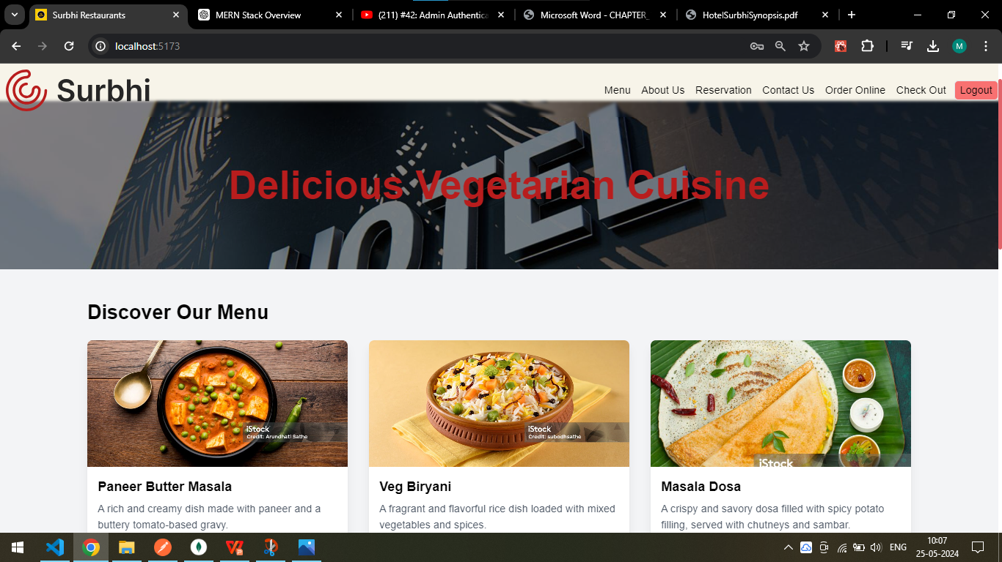
Home Screen

Slide 7
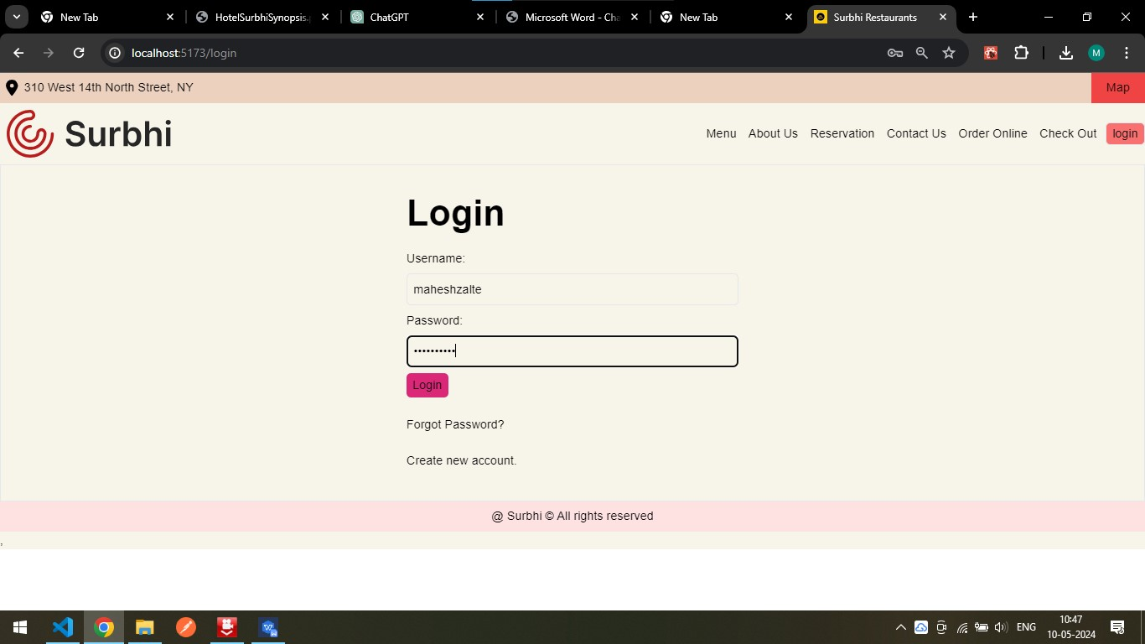
Login Page: This page allows patient login to the platform using credentials
Login page:

Slide 8
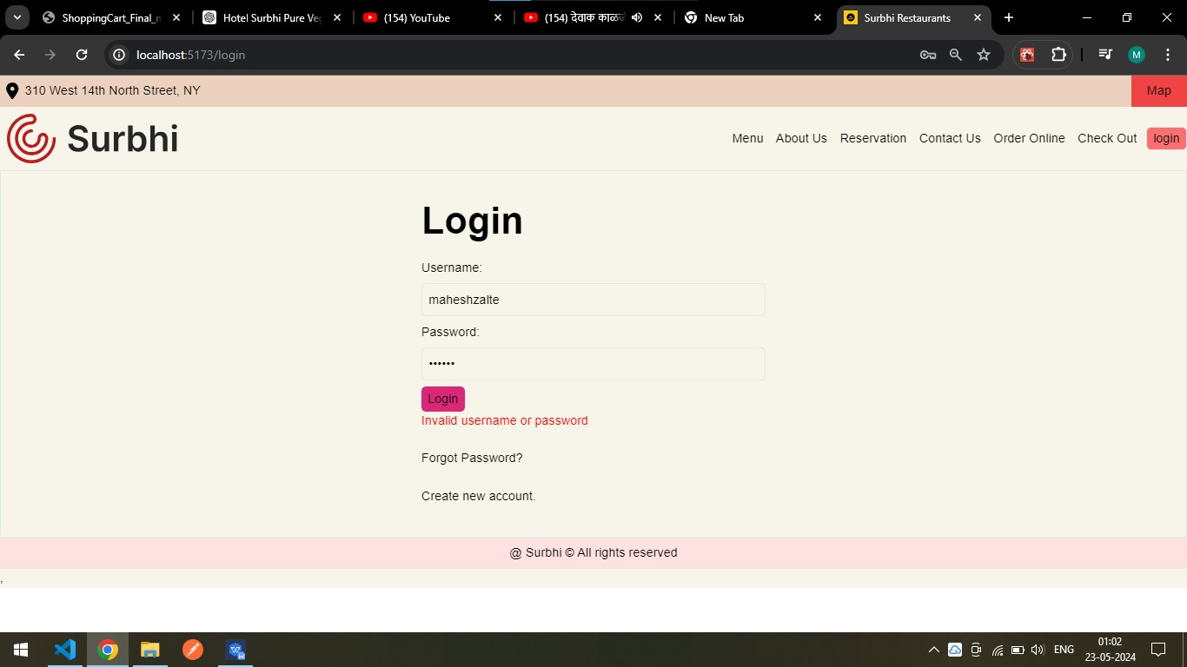
Login Validation:

Slide 9
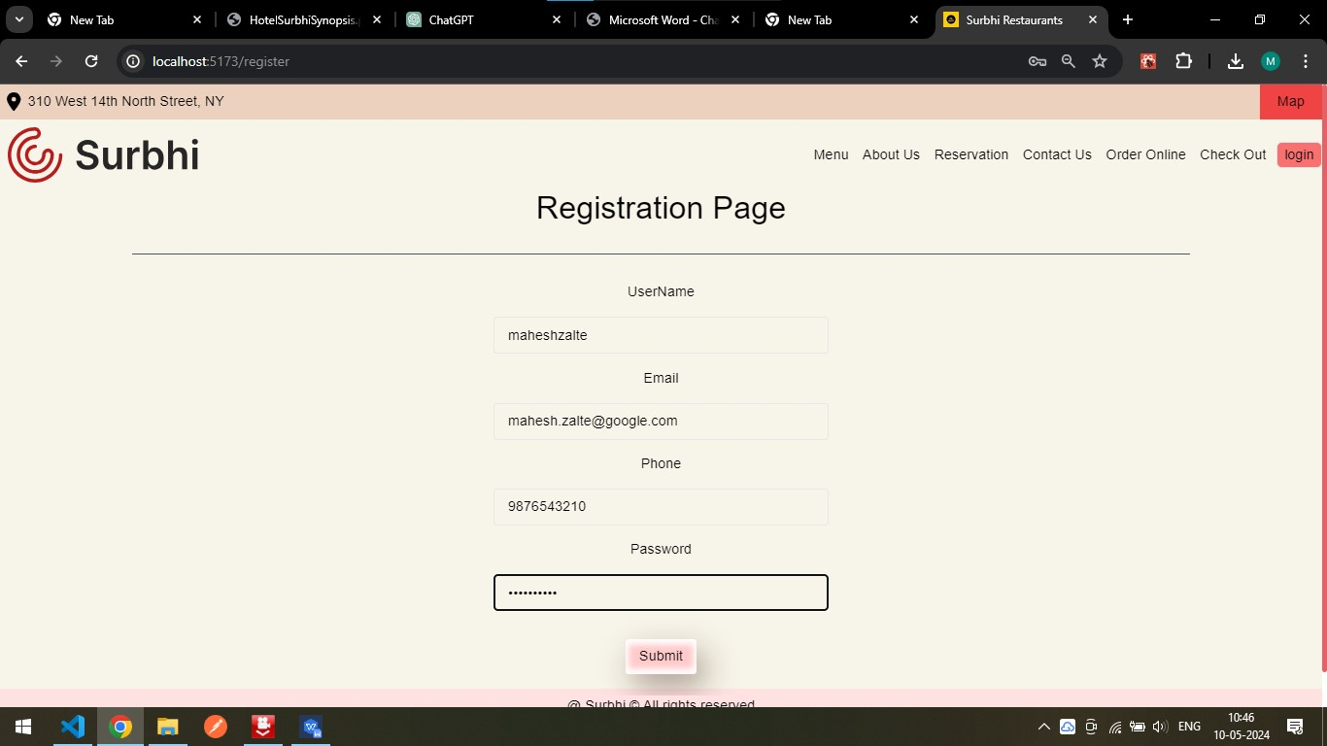
Registration Page:

Slide 10
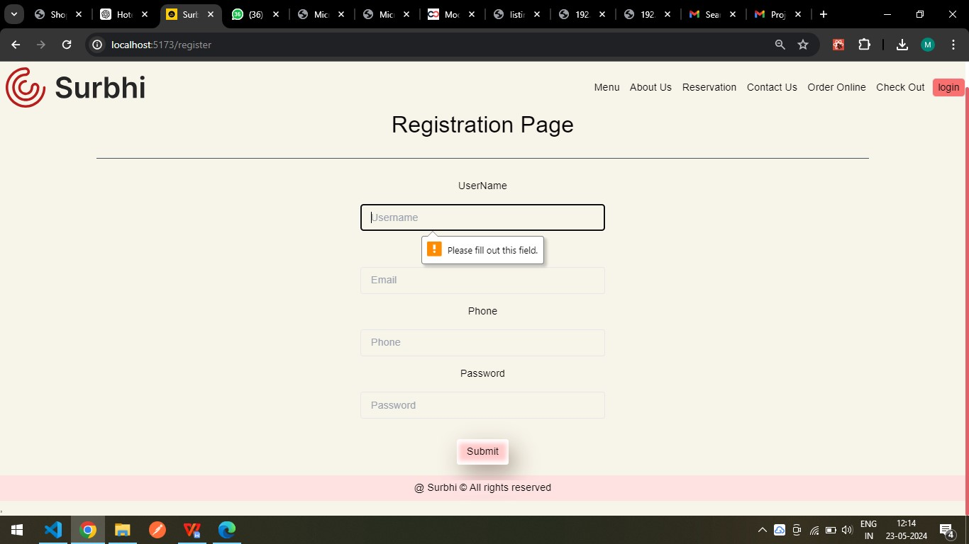
Validation for Registration:

Slide 11


